Slide 1
Reliable, Scalable and Maintainable Data Applications
Pravin Y Pawar

Slide 2
Data Processing Applications
Data Intensive Applications
Deals with
huge amount of data
complex data
fast moving data
Typically built with several building blocks like
Databases
Caches
Search Indexes
Streaming processing
Batch processing
Source : The topics are adapted from “Designing Data Intensive Applications” by Martin Kleppmann

Slide 3
Data Systems
Described
Many different tools are integrated together for the data processing task
Users are unaware about the seamless integration of tools / systems
The boundaries between the categories of tools is diminishing
No single tool can fit for all the data processing requirements
Need to make sure this integration works properly end to end

Slide 4
Non Functional Requirements for Data Systems
Three Requirements
Reliability
System should continue work correctly even in cases of failures
Scalability
System should be able to cope with increase in load
Maintainability
System should be able to work currently and adaptive to changes in future

Slide 5
Reliability
Described
System should continue to work correctly, even when things go wrong
Should carry out expected operation correctly
Should handle wrong user inputs
Should prevent unauthorized access and usage
Fault
Things that can go wrong
One component of system deviating from its working
Fault-tolerant / Resilient
Which can anticipate fault and deal with it properly
Failure
System as a whole stops providing services

Slide 6
Reliability(2)
Faults
Hardware Faults
Hard disk crash, RAM faults, Network issues etc
Add redundancy to individual components
Software Faults
Software bugs, multi-threading issues
Happens under very unusual set of circumstances, hard to reproduce again
No straight away answer, need to rethink about the assumptions made while designing the system
Human Errors
Developers designs the system, Operators maintains it
10-25% outages are caused by wrong configurations done by operators
Design systems that minimizes opportunities for error

Slide 7
Scalability
Described
Systems ability to cope with load
Load impacts the performance of system
Load defined differently for different data systems
Request per second, number of concurrent users etc
How system reacts when load increases?
If the system resources are kept same?
What additions needs to be done in systems resources?

Slide 8
Maintainability
Described
Easy to write a software , but very difficult to maintain it
Involves
Bug fixing
Keeping existing systems operational
Detecting root cause of failures
Adapting to new platforms
Legacy systems needs to be maintained as they are critical for the business operations.
Data Systems should be designed in such a way that
They are easily operable
They are simple to understand
They are easy to adapt to new changes

Slide 9
Maintainability (2)
Approaches
Operable
Easy to work with systems should be developed
Appropriate documentation to be provided
Monitoring capabilities should be present
Support for automation and integration with other tools should be possible
Simplified
Complexity slows down everything , makes maintenance hard, more vulnerable to errors
Simpler system does not mean compromise on features
Use Abstraction, it hides lot of complexity behind a clean interface
Finding good abstractions is hard
Extensible
Making changes should be easy
Adding new features, accommodating new requirements should be possible

Slide 10
Scaling with Traditional Databases
Pravin Y Pawar

Slide 11
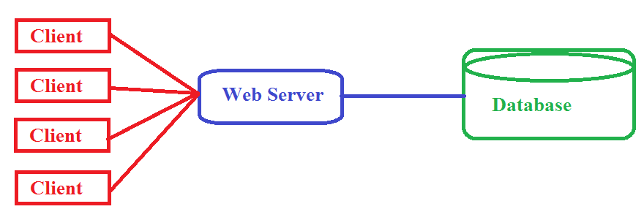
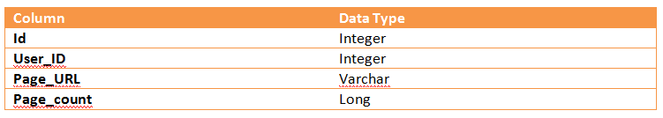
Web Analytics Application
Example Analytics Application
Designing an application to monitor the page hits for a portal
Every time a user visiting a portal page in browser, the server side keeps track of that visit
Maintains a simple database table that holds information about each page hit
If user visits the same page again, the page hit count is increased by one
Uses this information for doing analysis of popular pages among the users
Source : Adapted from Big Data by Nathan Marz

Slide 12
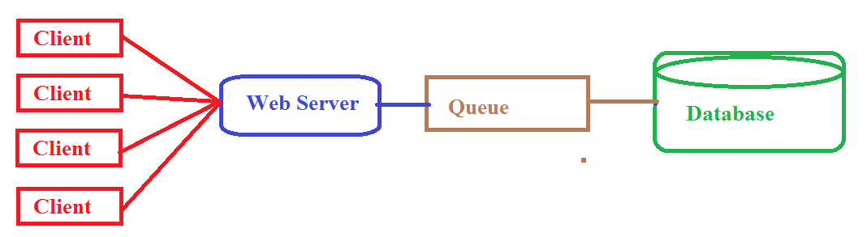
Scaling with intermediate layer
Using a queue
Portal is very popular, lot of users visiting it
Many users are concurrently visiting the pages of portal
Every time a page is visited, database needs to be updated to keep track of this visit
Database write is heavy operation
Database write is now a bottleneck
Solution
Use an intermediate queue between the web server and database
Queue will hold messages
Message will not be lost

Slide 13
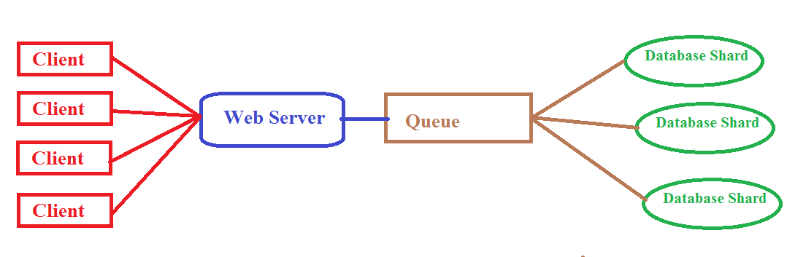
Scaling with Database Partitions
Using Database shards
Application is too popular
Users are using it very heavily, increasing the load on application
Maintaining the page view count is becoming difficult even with queue
Solution
Use database partitions
Data is divided into partitions which are hosted on multiple machines
Database writes are parallelized
Scalability increasing
Also complexity increasing

Slide 14
Issues Begins
Bottlenecks
Disks are prone to failure, hence partition can be inaccessible
Complicated to manage many number of shards
Repartitioning is again required when load increased
More buggy application code as complexity increasing
Difficult to retrieve from the mistakes done either by application code or humans

Slide 15
Rise of Big Data Systems
How it helps
Main issue with traditional data processing applications
Hard to make them scalable
Hard to keep them simple
Because everything is managed by application code
Which is more prone to mistakes due to buggy implementations
New edge systems aka Big Data Systems
Handles high data volume, at very fast rate coming from variety of sources
Systems aware about the distributed nature, hence capable of working with each other
Application does need to bother about common issues like sharding, replication etc
Scalability is achieved by horizontal scaling – just add new machines
Developers more focused on application logic rather than maintaining the environment

Slide 16
Big Data Systems
Pravin Y Pawar

Slide 17
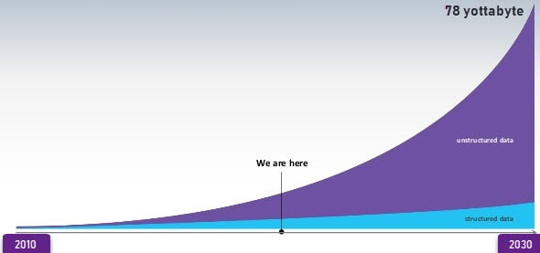
Data Growth
Data Generation
Source : https://www.guru99.com/what-is-big-data.html

Slide 18



Big Data Systems
What?
New Paradigm for Data Analytics
Information
Data
Insight

Slide 19




Data Classification
Types of Data
Databases
XML
Web pages
Images
Structured
Semi-structured
Unstructured

Slide 20
Data Usage Pattern
Usage Stats

Slide 21
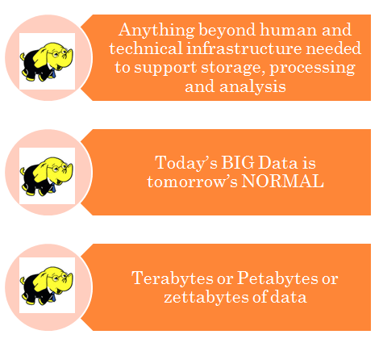
Big Data
Defined

Slide 22
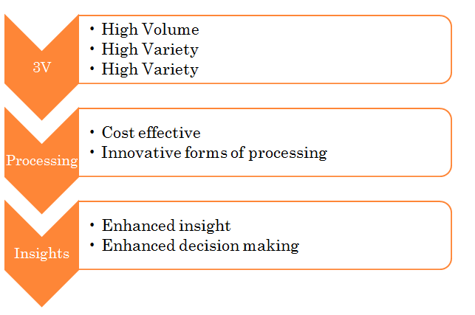
Big data – by Gartner

Slide 23
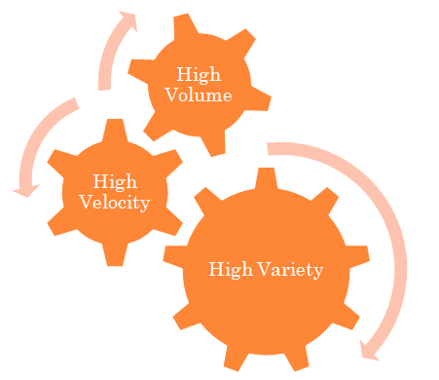
3 V’s of Big Data
Volume, Velocity and Variety

Slide 24

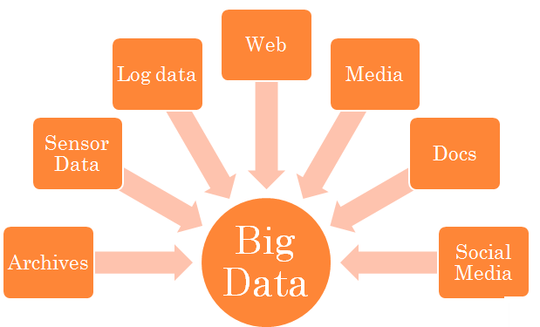
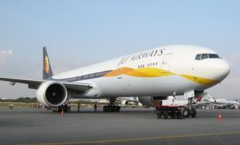

Sources of Big Data
New Age Data Sources
Source : https://www.guru99.com/what-is-big-data.html

Slide 25
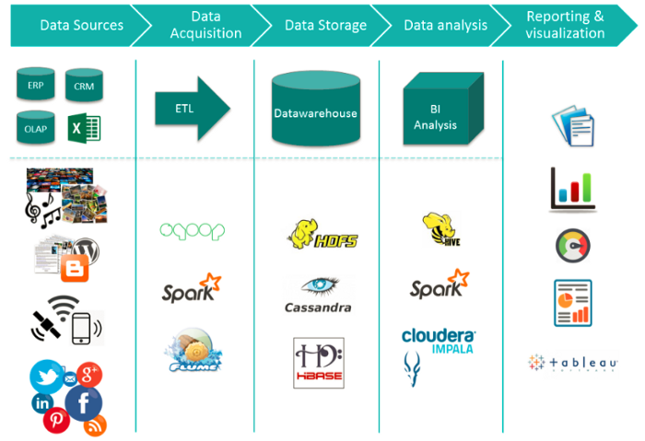
Big Data Ecosystem
Landscape of Big Data Systems
Source : https://medium.com/@jain6968/big-data-ecosystem-b0e4c923d7aa

Slide 26
Desired Properties of Big Data Systems
Pravin Y Pawar

Slide 27
Data Systems
Defined
System which answers the users questions based on the data accumulated over the period or in real time
What are the sales figures for last 6 months?
How is the health of data center at this moment?
Data is different from information
Information is derived from the data
Data systems makes use of data to answer users queries
Query = function (all data)
Source : Big Data , Nathan Marz

Slide 28
Properties of Big Data Systems
Properties
Fault tolerance
Correct behavior of system even in case of failures
Low latency
Both read and write response times should be as low as possible
Scalability
Easy to manage the load just by adding the additional machines
Extensibility
Easy to update or add new features in the system
Maintainability
Easy to keep system running without facing critical issues
Debuggability
Should be diagnose systems health if system behaves in inappropriate manner

Slide 29
Data Model of Big Data Systems
Pravin Y Pawar

Slide 30
Properties of Data
Three Properties
Rawness
Fine grained data
Many interesting queries can be answered
Unstructured data is more rawer than structured data
Immutability
No deletion or updates to data, only new addition
Original data is untouched
Easy to retrieve back from the failures / mistakes
No indexing required, enforcing simplicity
Eternity
Consequence of immutability
Data is always pure and true
Achieved with adding timestamp with the data
Source : Big Data , Nathan Marz

Slide 31
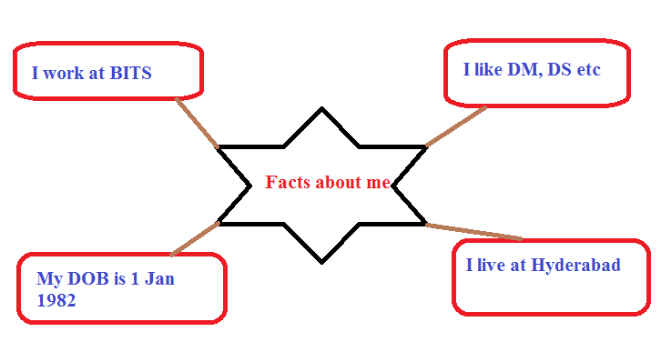
Fact based Model for Data
Facts
Fundamental unit of data
Data can not derived from anything else
Fact is atomic and time stamped
Can be made unique by adding unique identifier to it
Example facts
I work for BITS Pilani
My DOB is 1 January 1982
I currently live in Hyderabad
I was living at Pune between 2010 to 2015
I have interest in subjects like data mining, data science etc

Slide 32
Fact based Model for Data (2)
Benefits
Fact based model
Stores raw data as atomic facts
Makes facts immutable by adding time stamp value to it
Makes it uniquely identifiable by attaching identifier
Benefits
Data is query able at any time
Data is tolerant to human errors
Data can be stored both in structured and unstructured formats

Slide 33
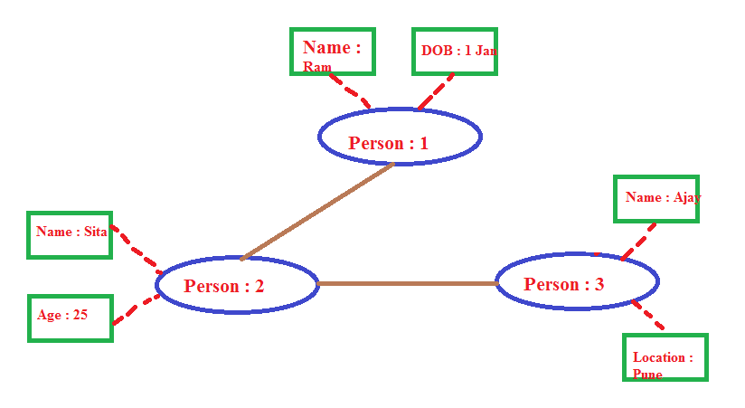
Fact based Model for Data (3)
Structure / Schema
Graph schemas captures the structure of dataset stored using fact based model
Depicts the relationship between nodes, edges and properties
Nodes
Entities in system , for example, person
Edges
Relationship between entities,
For example, person A knows person B
Properties
Information about entities

Slide 34
Generalized Architecture of Big Data Systems
Pravin Y Pawar

Slide 35
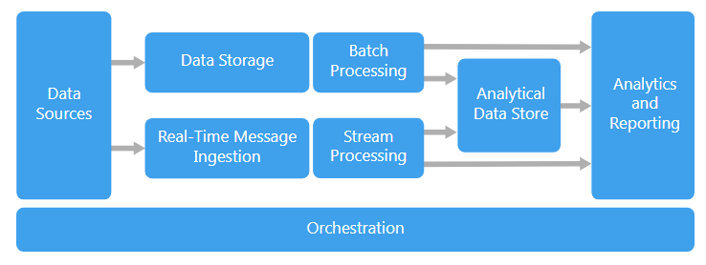
Big data architecture style
is designed to handle the ingestion, processing, and analysis of data that is too large or complex for traditional database systems.
Source : https://docs.microsoft.com/en-us/azure/architecture/guide/architecture-styles/big-data

Slide 36
Big Data Applications
Workloads
Big data solutions typically involve one or more of the following types of workload:
Batch processing of big data sources at rest
Real-time processing of big data in motion
Interactive exploration of big data
Predictive analytics and machine learning

Slide 37
Big Data Systems Components
Components
Most big data architectures include some or all of the following components:
Data sources
All big data solutions start with one or more data sources like databases, files, IoT devices etc
Data Storage
Data for batch processing operations is typically stored in a distributed file store that can hold high volumes of large files in various formats.
Batch processing
Because the data sets are so large, often a big data solution must process data files using long-running batch jobs to filter, aggregate, and otherwise prepare the data for analysis. Usually these jobs involve reading source files, processing them, and writing the output to new files.
Real-time message ingestion
If the solution includes real-time sources, the architecture must include a way to capture and store real-time messages for stream processing.
Stream processing
After capturing real-time messages, the solution must process them by filtering, aggregating, and otherwise preparing the data for analysis. The processed stream data is then written to an output sink.
Analytical data store
Many big data solutions prepare data for analysis and then serve the processed data in a structured format that can be queried using analytical tools. The analytical data store used to serve these queries can be a Kimball-style relational data warehouse, as seen in most traditional business intelligence (BI) solutions.
Analysis and reporting
The goal of most big data solutions is to provide insights into the data through analysis and reporting.
Orchestration
Most big data solutions consist of repeated data processing operations, encapsulated in workflows, that transform source data, move data between multiple sources and sinks, load the processed data into an analytical data store, or push the results straight to a report or dashboard. To automate these workflows, you can use an orchestration technology such Azure Data Factory or Apache Oozie and Sqoop.

Slide 38
Big data architecture Usage
When to use this architecture
Consider this architecture style when you need to:
Store and process data in volumes too large for a traditional database
Transform unstructured data for analysis and reporting
Capture, process, and analyze unbounded streams of data in real time, or with low latency

Slide 39
Big data architecture Benefits
Advantages
Technology choices
Variety of technology options in open source and from vendors are available
Performance through parallelism
Big data solutions take advantage of parallelism, enabling high-performance solutions that scale to large volumes of data.
Elastic scale
All of the components in the big data architecture support scale-out provisioning, so that you can adjust your solution to small or large workloads, and pay only for the resources that you use.
Interoperability with existing solutions
The components of the big data architecture are also used for IoT processing and enterprise BI solutions, enabling you to create an integrated solution across data workloads.

Slide 40
Big data architecture Challenges
Things to ponder upon
Complexity
Big data solutions can be extremely complex, with numerous components to handle data ingestion from multiple data sources. It can be challenging to build, test, and troubleshoot big data processes.
Skillset
Many big data technologies are highly specialized, and use frameworks and languages that are not typical of more general application architectures. On the other hand, big data technologies are evolving new APIs that build on more established languages.
Technology maturity
Many of the technologies used in big data are evolving. While core Hadoop technologies such as Hive and Pig have stabilized, emerging technologies such as Spark introduce extensive changes and enhancements with each new release.

Slide 41
Thank You!

